Slide 1
FYP Presentation
Anns Shahzad
Abdul Subhan
Muhammad Hassan Ijaz
Mr. Aizaz Akmal
Department of Computer Science
University of Engineering and Technology, KSK Campus Lahore

Slide 2
Introduction
Today, Discovery of Fake Product is a great Challenge.
Fake Items are causing damages to organization’s reputation.
Fake Items are also causing bad impact on consumers.
To detect the fake product with fully secure channel we are implementing this system using Blockchain.

Slide 3
Scope of Work
Create Smart Contract for Product Authenticity Protection.
Analysis of Region wise Fake Products.
Interface of Web App for Manufacturer/Company to control and supervised the assets.
Quick and Easy usage of Mobile App for Consumer.
Generating the QR codes from the hash of blocks.
Develop a Distributor tab, so they can be supervised and added by the Manufacturer.

Slide 4
Socio-Economic Benefits
Application is Interactive and Easy-to-use.
User get a single platform where he can easily validate the products.
Manufacturer credibility and sales increase.
Currently, according to surveys, there are 40-50 percent fake products being distributed in Pakistan.
It has a great potential to decrease ratio of Fake Product Vendors/Imposters.

Slide 5
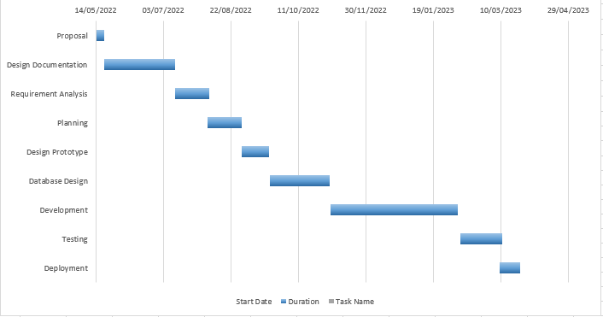
Project Plan (Gantt Chart)

Slide 6
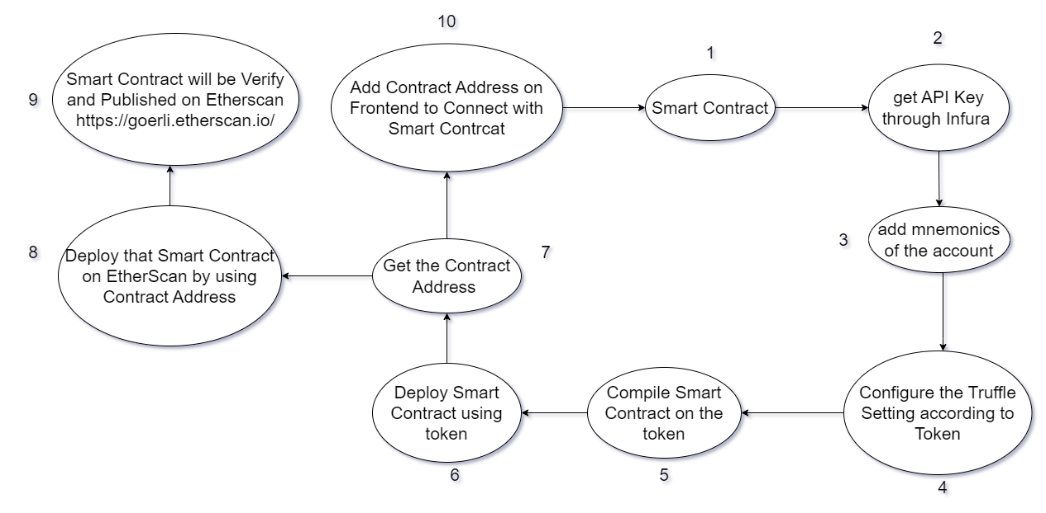
Workflow of Smart Contract

Slide 7
Platforms
What is happening | What we are using. | Alternatives
Smart Contract | Solidity | Rust, Vyper.
API Key | Infura | Drizzle, Alchemy

Slide 8
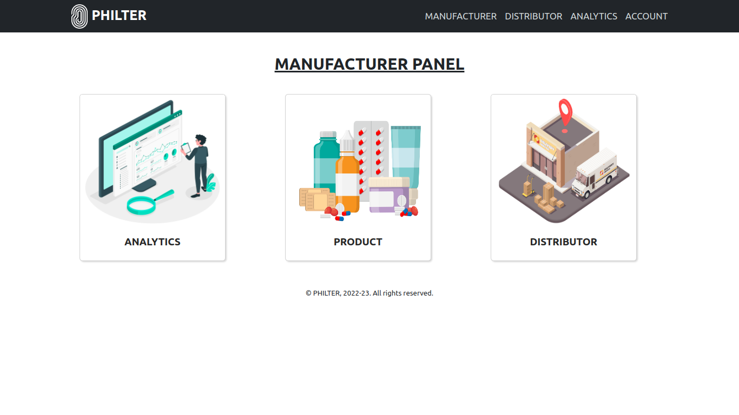
Progress
Website interface is almost complete.
Smart Contract for Product & Distributor has been implemented.

Slide 9
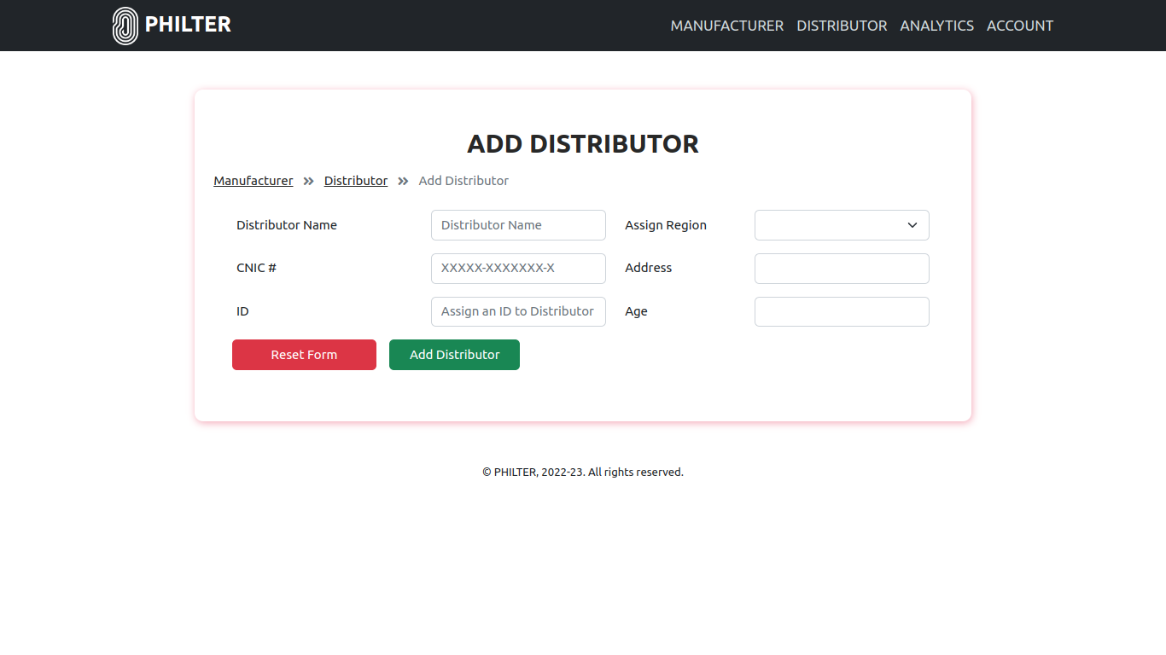
Progress

Slide 10
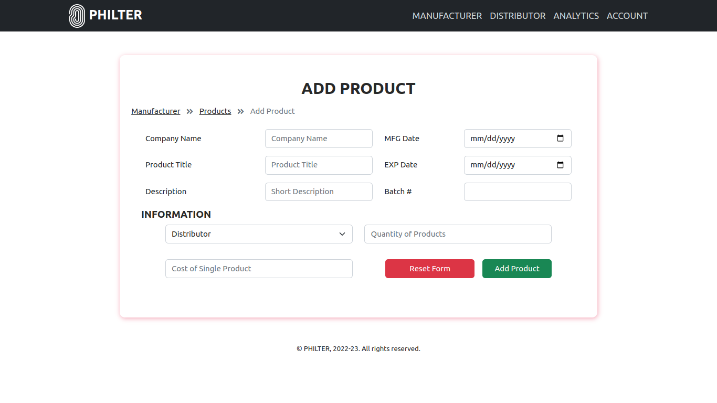
Progress

Slide 11
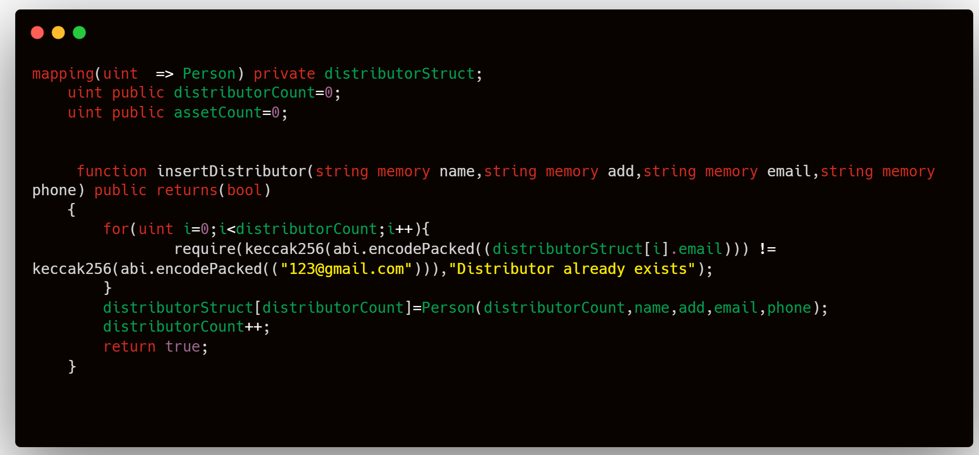
Progress
Distributor Insertion code snippet in the Smart Contract.

Slide 12
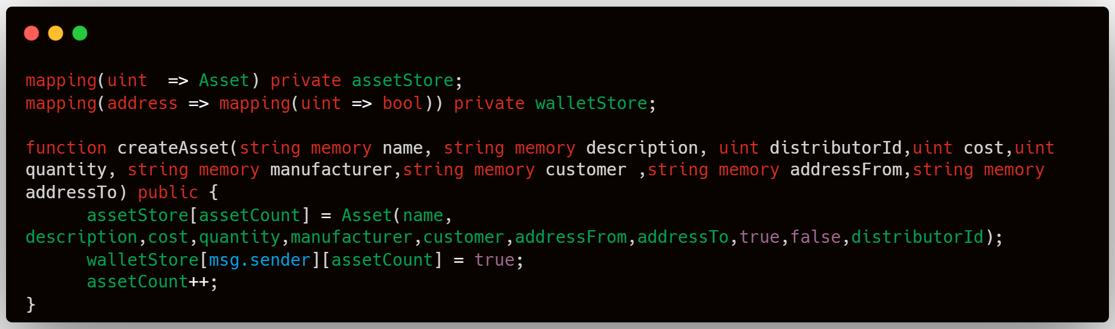
Progress
Product Insertion code snippet in the Smart Contract.

Slide 13
Future Tasks
Add Panel for the Distributor.
Add more areas for Manufacturers to analyze the fakeness ratio of Products.
Add more types of Products like cosmetics, etc.

Slide 14
REFERENCES
[1] Lamiya Simran proma, Pranto biswas. East West University Publishing 2021.
[2] singhal, Ishaan “Anti counterfeit product system”, December 2021, page no: 08

